Slide 1
Asymptotic Order of Growth
Standard Notations and Common Functions
Lecture 5

Slide 2
Good Algorithms?
Run in less time
Consume less memory
But computational resources (time complexity) is usually more important

Slide 3
Measuring Efficiency
The efficiency of an algorithm is a measure of the amount of resources consumed in solving a problem of size n.
  The resource we are most interested in is time
  We can use the same techniques to analyze the consumption of other resources, such as memory space.

Slide 4
Factors affecting running time of algorithm
Hardware
Operating System
Compiler
Input size
How much time statements are executed

Slide 5
Running Time of an Algorithm
Depends upon
    Input Size
    How much time statements are executed
Generally time grows with size of input, so running time of an algorithm is usually measured as function of input size.
Running time is measured in terms of number of steps/primitive operations performed
Independent from machine, OS

Slide 6
Finding running time of an Algorithm / Analyzing an Algorithm
Running time is measured by number of steps/primitive operations performed
Steps means elementary operation like
  ,+, *,<, =, A[i] etc
We will measure number of steps taken in term of size of input

Slide 7
Simple Example (1)
// Input: int A[N], array of N integers
// Output: Sum of all numbers in array A
int Sum(int A[], int N)
{
int s=0;
for (int i=0; i< N; i++)
s = s + A[i];
return s;
}
How should we analyse this?

Slide 8
Simple Example (2)
// Input: int A[N], array of N integers
// Output: Sum of all numbers in array A
int Sum(int A[], int N){
int s=0;
for (int i=0; i< N; i++)
s = s + A[i];
return s;
}
1
2
3
4
5
1,2,8: Once
3,4,5,6,7: Once per each iteration
of for loop, N iteration
Total: 5N + 3
The complexity function of the
algorithm is : f(N) = 5N +3
6
7
8

Slide 9
What Dominates in Previous Example?
What about the +3 and 5 in 5N+3?
  As N gets large, the +3 becomes insignificant
  5 is inaccurate, as different operations require varying amounts of time and also does not have any significant importance
What is fundamental is that the time is linear in N.
Asymptotic Complexity: As N gets large, concentrate on the
highest order term:
  Drop lower order terms such as +3
  Drop the constant coefficient of the highest order term i.e. N

Slide 10
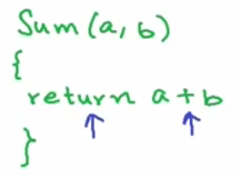
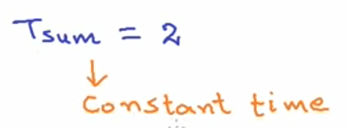
HOW TO ANALYZE TIME COMPLEXITY?
Notes:
http://isites.harvard.edu/fs/docs/icb.topic600780.files/loop_analysis.pdf

Slide 11
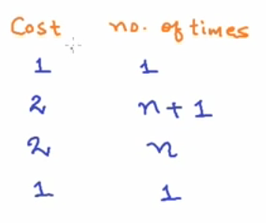
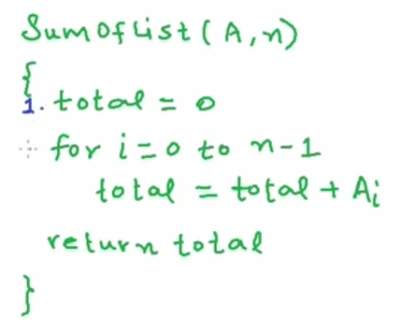
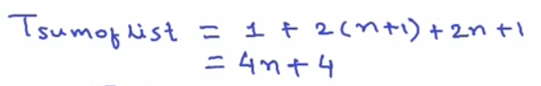
HOW TO ANALYZE TIME COMPLEXITY?
Notes:
http://isites.harvard.edu/fs/docs/icb.topic600780.files/loop_analysis.pdf

Slide 12
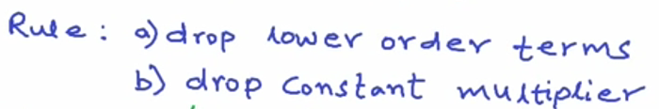
time complexity analysis-some general rules
We analyse time complexity for:
a) Very large input size
b) Worst case scenario
Notes:
http://isites.harvard.edu/fs/docs/icb.topic600780.files/loop_analysis.pdf

Slide 13
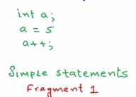
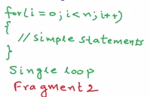
time complexity analysis-some general rules
Rule: Running time = ∑ Running time of all the fragments
O(1) O(n)
Notes:
http://isites.harvard.edu/fs/docs/icb.topic600780.files/loop_analysis.pdf

Slide 14
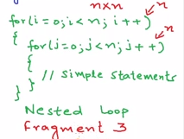

time complexity analysis-some general rules
Rule: Running time = ∑ Running time of all the fragments
Notes:
http://isites.harvard.edu/fs/docs/icb.topic600780.files/loop_analysis.pdf

Slide 15
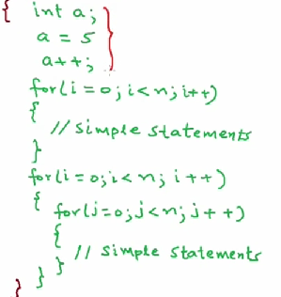


time complexity analysis-some general rules
Notes:
http://isites.harvard.edu/fs/docs/icb.topic600780.files/loop_analysis.pdf

Slide 16
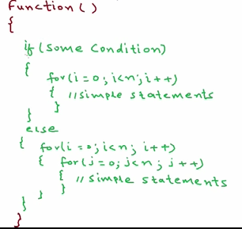
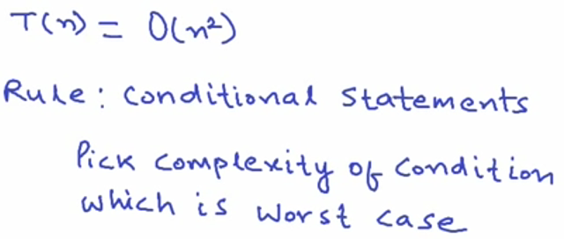
time complexity analysis-some general rules
Notes:
http://isites.harvard.edu/fs/docs/icb.topic600780.files/loop_analysis.pdf

Slide 17
Order of growth
    The change in the behavior of algorithm as the input size grows is called the Order of growth of an algorithm.
    Generally, when you have to find order of growth you go for higher value of n. why?
Notes:
Generally With smaller n algorithms performance is fine.
And all the real time applications deal with higher value of n.

Slide 18
Kinds of analyses
  Best-case: what is the fastest an algorithm can run for a problem of size N?
  Average-case: on average how fast does an algorithm run for a problem of size N?
  Worst-case: what is the longest an algorithm can run for a problem of size N?

Slide 19
Kinds of analyses
Let us consider the following implementation of Linear Search. A= {5,7,2,1,6,8,10,4,15,13,12,20,31,11,17,25} // Linearly search x in A[]. If x is present then return the index, // otherwise return -1 int search(int n, int x) { int i; for (i=0; i<n; i++) { if (A[i] == x) return i; } return -1; }

Slide 20
Kinds of analyses
Search(5) --best case, 1 comparison– 1 COM
Search(4) --- n/2
Search(25) –worst case, 16 comparison – N COM
Search(100) –worst case, element searched is not present.
Best case -- Cbest(n)=1, MINIMUM NO OF COMPARISONS
Worst case --CWorst(n)=n,MAXIMUM NO OF COMPARISONS
Average Case -- AVERAGE NO OF COMPARISONS
MOST IMPORTANT IS THE WORST CASE.

Slide 21
Kinds of analyses
Worst Case Analysis (Usually Done)
For Linear Search, the worst case happens when the element to be searched (x in the above code) is not present in the array. When x is not present, the search() functions compares it with all the elements of one by one.
Average Case Analysis (Sometimes done)
In average case analysis, we take all possible inputs and calculate computing time for all of the inputs. Sum all the calculated values and divide the sum by total number of inputs.
Best Case Analysis
In the best case analysis, we calculate lower bound on running time of an algorithm. We must know the case that causes minimum number of operations to be executed. In the linear search problem, the best case occurs when x is present at the first location. The number of operations in the best case is constant (not dependent on n).

Slide 22
Asymptotic notation
    Asymptotic notation is a way to classify the running time of an algorithm into generic and broad classes.
Notes:
But we have very formal way of classifying functions in classes

Slide 23

The theta notation bounds a functions from above and below, so it defines exact asymptotic behavior.
A simple way to get Theta notation of an expression is to drop low order terms and ignore leading constants. For example, consider the following expression.
3n³ + 6n² + 6000 = Θ(n³)
Dropping lower order terms is always fine because there will always be a n0 after which Θ(n³) beats Θn²) irrespective of the constants involved.
For a given function g(n), we denote Θ(g(n)) is following set of functions.

Slide 24
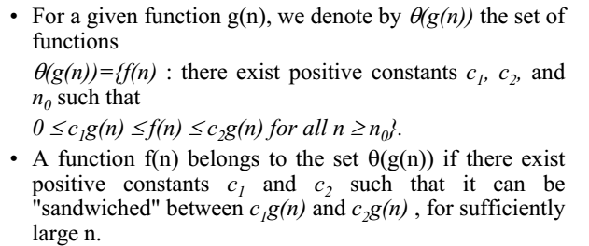
ASYMPTOTIC NOTATION
Notes:
What are the operations of the order of growth.

Slide 25
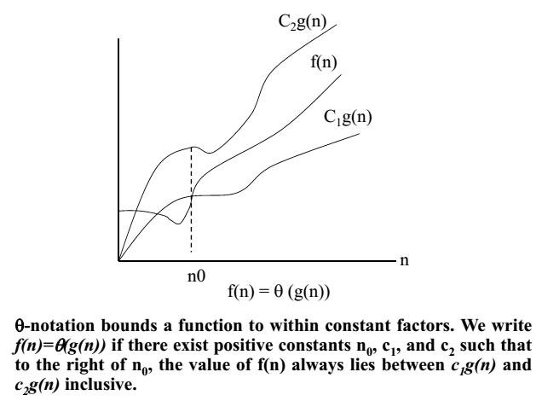
θ-notation
Notes:
It is the average time.
This function f(n) is bound from above n below by constant multiples of g(n)
The growth rate of function f(n) will lie between growth rate of

Slide 26
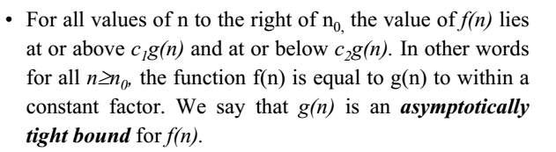

Slide 27
Big O Notation
The Big O notation defines an upper bound of an algorithm, it bounds a function only from above. For example, consider the case of Insertion Sort. It takes linear time in best case and quadratic time in worst case. We can safely say that the time complexity of Insertion sort is O(n^2). Note that O(n^2) also covers linear time.
If we use Θ notation to represent time complexity of Insertion sort, we have to use two statements for best and worst cases:
1. The worst case time complexity of Insertion Sort is Θ(n^2).
2. The best case time complexity of Insertion Sort is Θ(n).
The Big O notation is useful when we only have upper bound on time complexity of an algorithm. Many times we easily find an upper bound by simply looking at the algorithm.
O(g(n)) = { f(n): there exist positive constants c and n0 such that 0 <= f(n) <= cg(n) for all n >= n0}

Slide 28

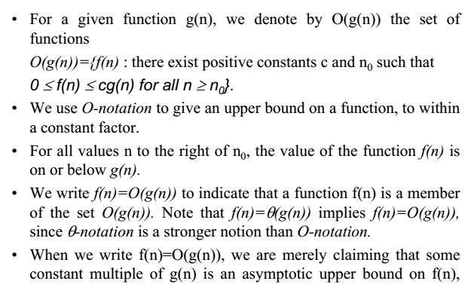
Notes:
It is the maximum time an algorithm can take to complete its execution.
The maximum time f(n) will take will not be more than time taken by g(n)
The growth rate of f(n) will be less than growth.
The longest time an algorithm takes to complete its execution.

Slide 29
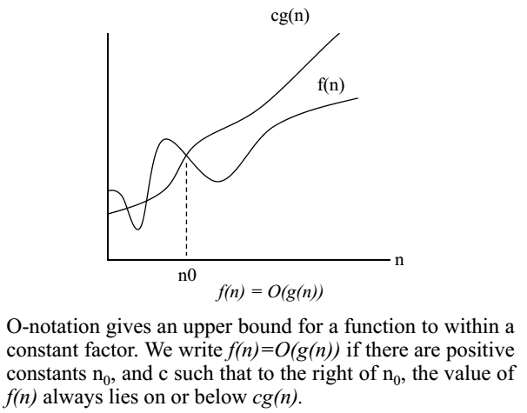

Slide 30
Ω Notation:
Just as Big O notation provides an asymptotic upper bound on a function, Ω notation provides an asymptotic lower bound.
Ω Notation< can be useful when we have lower bound on time complexity of an algorithm. As discussed in the previous post, the best case performance of an algorithm is generally not useful, the Omega notation is the least used notation among all three.
For a given function g(n), we denote by Ω(g(n)) the set of functions.
Ω (g(n)) = {f(n): there exist positive constants c and n0 such that 0 <= cg(n) <= f(n) for all n >= n0}.Let us consider the same Insertion sort example here. The time complexity of Insertion Sort can be written as Ω(n), but it is not a very useful information about insertion sort, as we are generally interested in worst case and sometimes in average case.

Slide 31

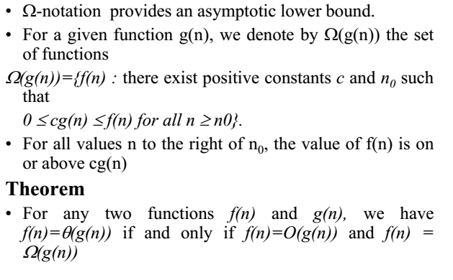
Notes:
The least time an algorithm takes to complete its execution.
The least time f(n) takes will not be less than g(n)

Slide 32
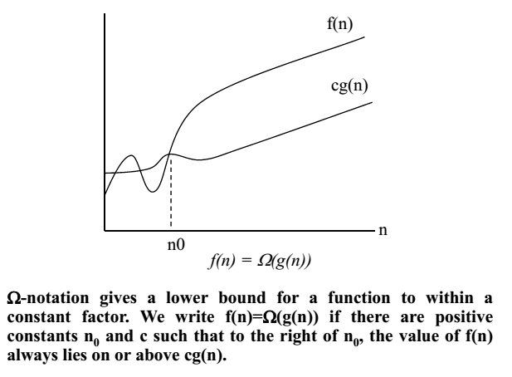

Slide 33
Practical significance of notations
Given any algorithm the big Oh ‘O’ will give you the worst case time of an algorithm.
Given any algorithm the big Omega will give you the best case.
Given any algorithm the big Theta will give you the average case.
Practically we are interested in worst case.
Notes:
=if you are giving your time in terms of big O that means in any case your time will never exceeds this.
=if you are giving your time in terms of big omega that means in any case your time will never be less of it, least time possible.

Slide 34
Practical significance of notations
What is the best, average and worst case analysis of search in this array?
    5, 7, 1, 2, 4, 10, 20, 11

Slide 35
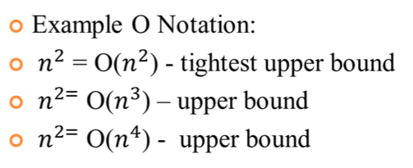
example

Slide 36
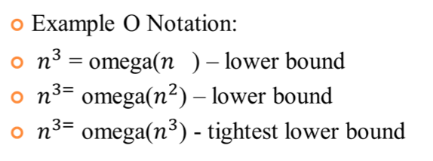
example

Slide 37
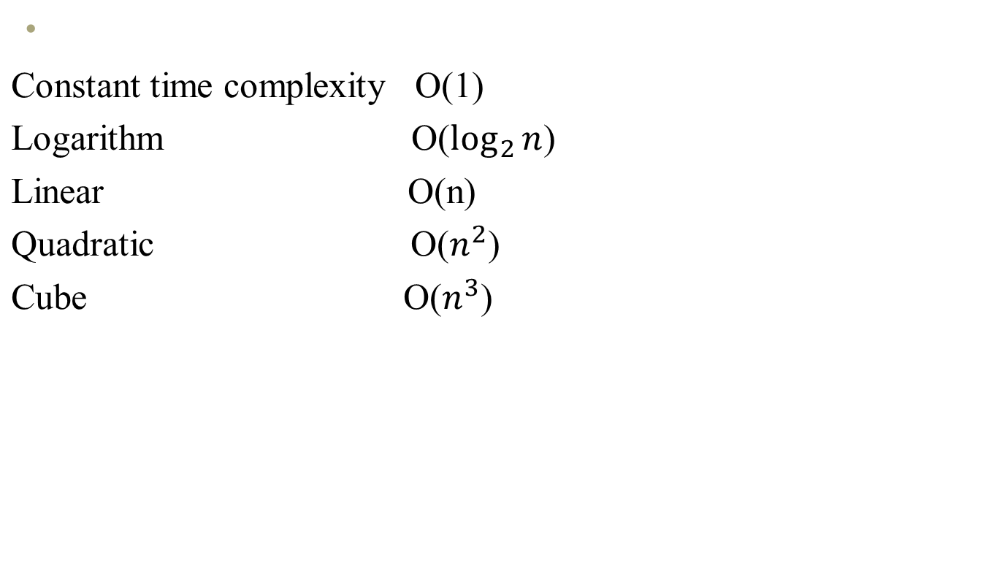
Types of time complexity

